Slide 1

Abide Profit Solutions
Jordan Lange

Slide 2
Net Profit (”The bottom Line”) is the most important financial measure of a business
The Problem
BUT,
Small business owners can’t answer these questions:
“Who are my most net profitable customers?”
“What are my most net profitable products?”
“What minimum order quantity should I set on this product to break even on net profit?”

Slide 3



An Example:
Annual Income Statement
Products
Annual Revenue
Annual Net Profit
Revenue:
$470k
$300k
-$100k
$200k
COGS:
Product 1
Gross Margin:
$270k
Operating Cost:
$290k
$100k
$30k
Product 2
-$20k
Net Profit:
$70k
$50k
Product 3
TOTALS
$470k
-$20k

Slide 4


Problem – Continued
Net Profit is the most important measure of any business.
How do you know that when you sell a product it is a profitable sale for your bottom line? – Nobody can.
Access to solutions such as consulting and data analysis give large businesses an unfair advantage to make effective decisions.
Most of the net profit in the business is generated on a select few products or customers but businesses can’t see it because of Averaged Income Statement
No visibility into net profit.

Slide 5
Solution
Democratize Modern Profit Data Analysis Techniques For Small Businesses

Slide 6
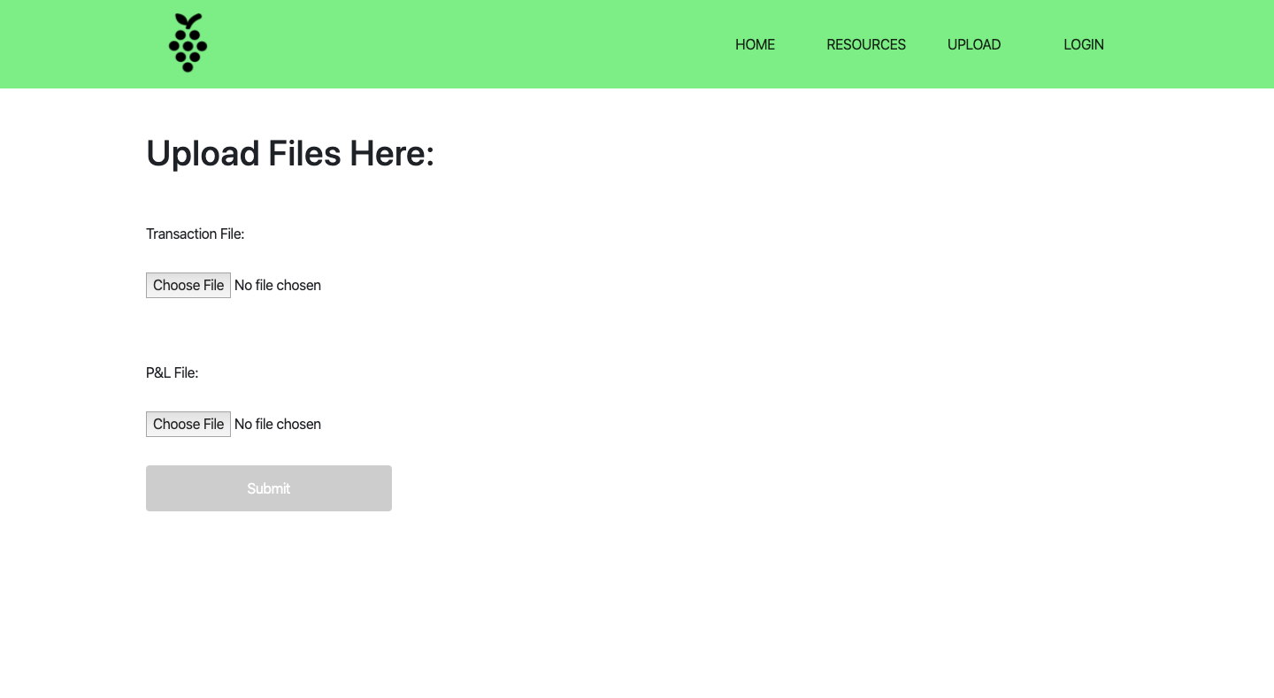
The product
1
Upload your P&L/GL and Transaction data
2
The software splits all the costs in
the business to each transaction
3
You can easily see the bulk
of company profitability across
a number of dimensions

Slide 7
Output
Answer any question a business owner has in terms of the bottom line.
”Which of my customers is giving me the most NP?”
”Which products are contributing most to my NP?”
“Are there facets of my operations that are losing money?”
Order sizes analysis (Order size effects profit! - Are you bundling properly?)
Marketing efficiency analysis (Are you spending your marketing dollars on the right people and right products?)

Slide 8
Output – Continued
Net Profit (“The bottom line”) is only visible at a company-level
*See it by “Customer,” ”Product,” “Order Size,” “Price”

Slide 9
Market and Competition – Small Business quickbooks users in the Retail/wholesale industry
30.2 M small businesses in America (Source)
Small businesses employ 58.9 million people, which makes up 47.5% of the country’s total employee workforce.
30.2 M Small Businesses in US
22M Quickbooks Users
~3.7 M Retail/Wholesale

Slide 10
Market and Competition – Quickbooks App Store
QuickBooks has over 29 million small business customers in the US with 80% market share. (Source )
As of 2019 the QuickBooks app store had 600 applications.
The category “Perform Analytics” has 75 applications (Source).
Some of the biggest “Perform Analytics” Applications
Name | Link to Site | Price | #Reviews (proxy for users) | Estimated annual income
Syft Analytics | Website | >$49/month | 131 | $1.5 M
Qvinci | Website | $21.95/file synced/month | 137 | ?
Fathom | Website | >$39/month | 109 | $1 M
LivePlan | Website | $19.95/month | 105 | $0.5 M
*Assuming a 5% Review:User ratio.

Slide 11
Pricing Model (?)
Goal: Make it affordable for small businesses with opportunity to scale
Guarantee: Find opportunity worth 10% of total NP
Free Trial
Business
Professional
Enterprise
Free
$10/mo
$30/mo
$100/mo
+ consulting fees
Features:
Features:
Features:
Features:
- Upload a subset of data
- Get a “teaser” look at bottom products/customers
- Upload all data
- Full reporting on all products/customers
Data size constraints/queries volume
Data Export
Unlimited data storage
Unlimited uploads
Consulting services

Slide 12
Strategy Phase 1: Product Dev
Work to a proof of concept wireframe/mockup in Jupyter and functionalize (v1)
Manually test data with 3-5 friend’s businesses for free tweaking concept and inbound data requirements as needed. Market testing/concept feedback. Establish pricing model.
Build a v2 version leveraging GCP for data storage and generate Flask application/front end. Payment processing component.
Test again with 2-3 businesses
Create Quickbooks Application and put on app store

Slide 13

About Jordan

Slide 14
I’ve learned from the best
I’m passionate about small business.
I’ve been managing a team who is working on this cutting-edge tech for 3 years.
Other impressive stuff.

Slide 15
Keys to success
Training and Teaching materials
Make it affordable
Customer Service

Slide 16
Appendix
Report on Small Businesses

